Slide 1
Load Balancing Algorithms

Slide 2
Load Balancing Algorithms
Static
Sticky Round Robing
Round Robin
Weighted Round Robing
Hash
Dynamic
Least Connection
Response Time

Slide 3
Round Robin
The Round Robin algorithm is a simple static load balancing approach in which requests are distributed across the servers in a sequential or rotational manner. It is easy to implement but it doesn’t consider the load already on a server so there is a risk that one of the servers receives a lot of requests and becomes overloaded.

Slide 4
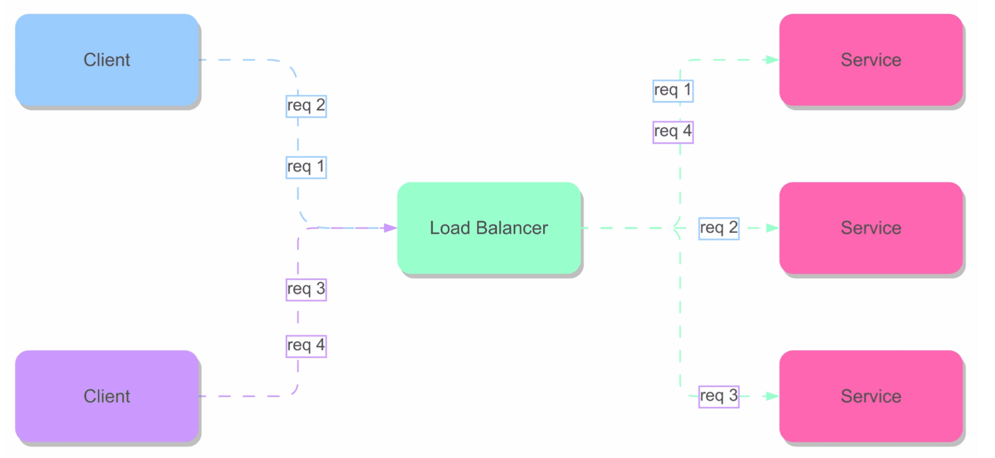
Round Robin

Slide 5
Sticky Round Robin
The Sticky Round Robin algorithm (often referred to as session affinity Round Robin or simply sticky sessions) is a variant of the standard Round Robin load balancing algorithm that adds a “stickiness” component. This stickiness ensures that once a client is assigned to a particular server, subsequent requests from that same client are routed to the same server, as long as the session remains active.

Slide 6
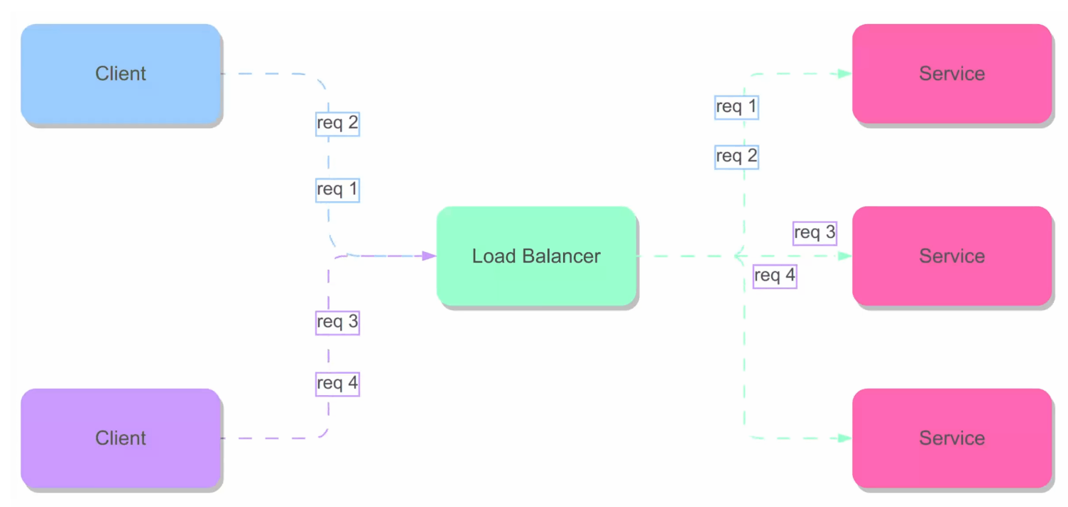
Sticky Round Robin

Slide 7
Weighted Round Robin
The Weighted Round Robin algorithm is also a static load balancing approach which is much similar to the round-robin technique. The only difference is, that each of the resources in a list is provided a weighted score. Depending on the weighted score the request is distributed to these servers.
Servers with higher weights are given a larger proportion of the requests.
The distribution is cyclic, similar to the round-robin technique, but with each server receiving a number of requests proportional to its weight.

Slide 8
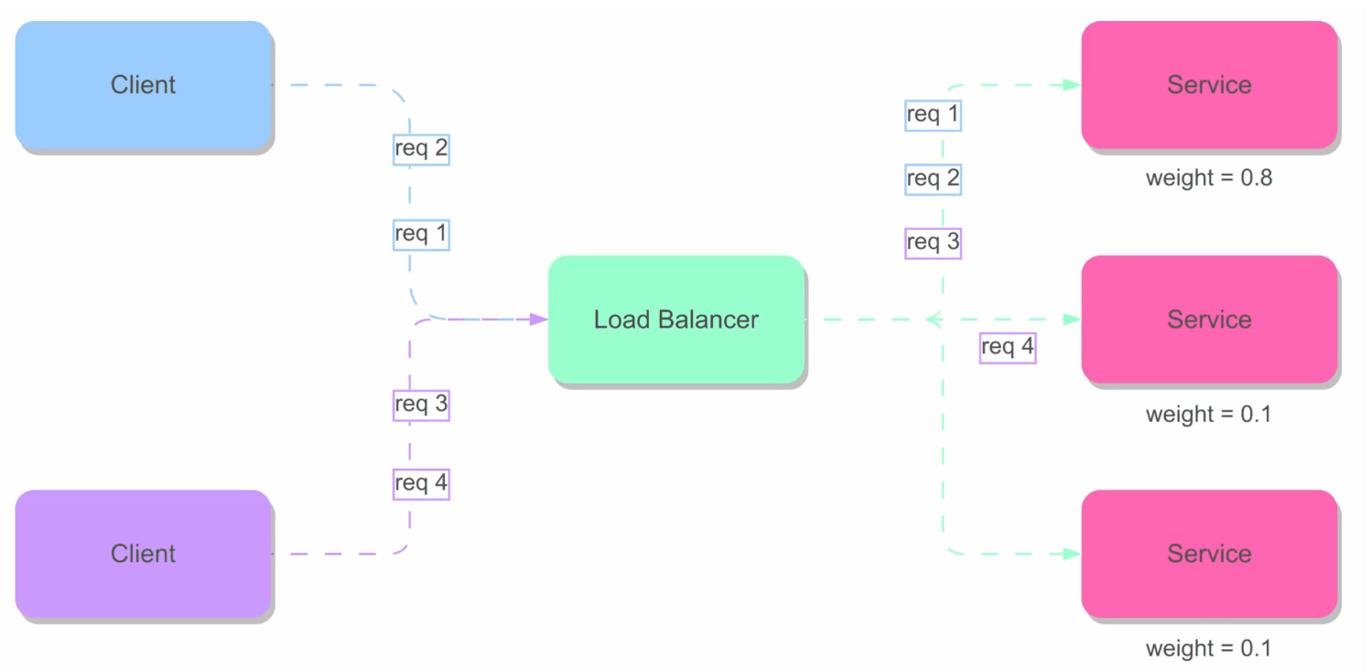
Weighted Round Robin

Slide 9
Hash
Hash load balancing is a technique that uses the source and destination IP addresses of a data packet to determine which server in a pool of servers should handle the request. The load balancer performs a mathematical calculation (hash function) on the IP addresses to generate a hash value, which is then used to select the server.

Slide 10
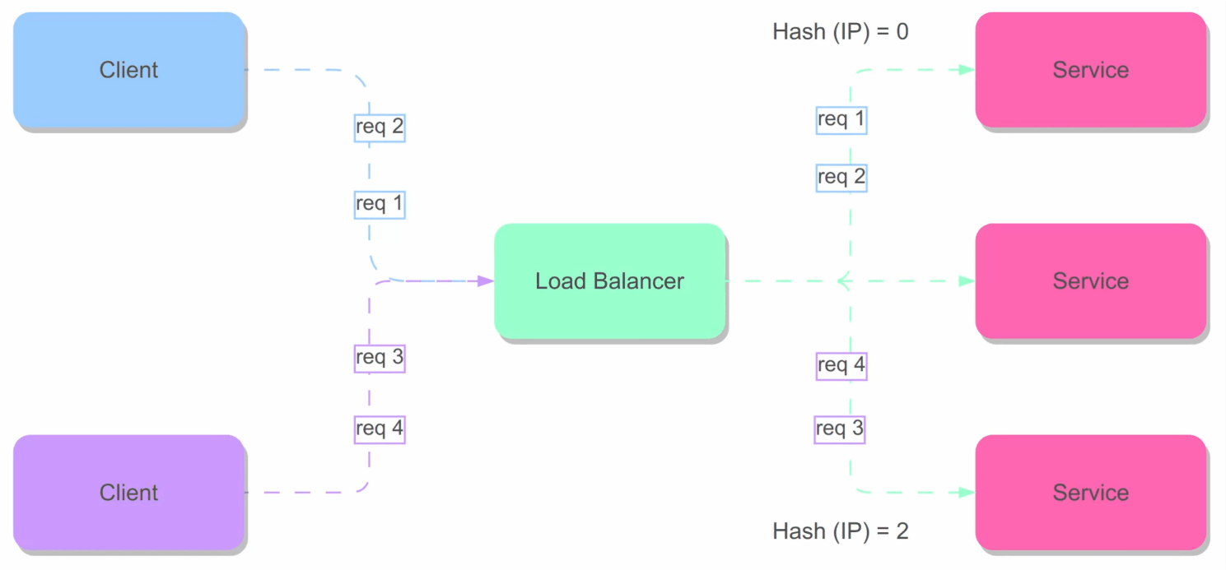
Hash

Slide 11
Least Connections
The Least Connections load balancing algorithm is a dynamic algorithm that distributes incoming requests to the server that is currently managing the fewest open connections at the time the new connection request is received. This algorithm takes into account the current number of active connections on each server and forwards new requests to the server that is currently serving the lowest number of active connections.

Slide 12
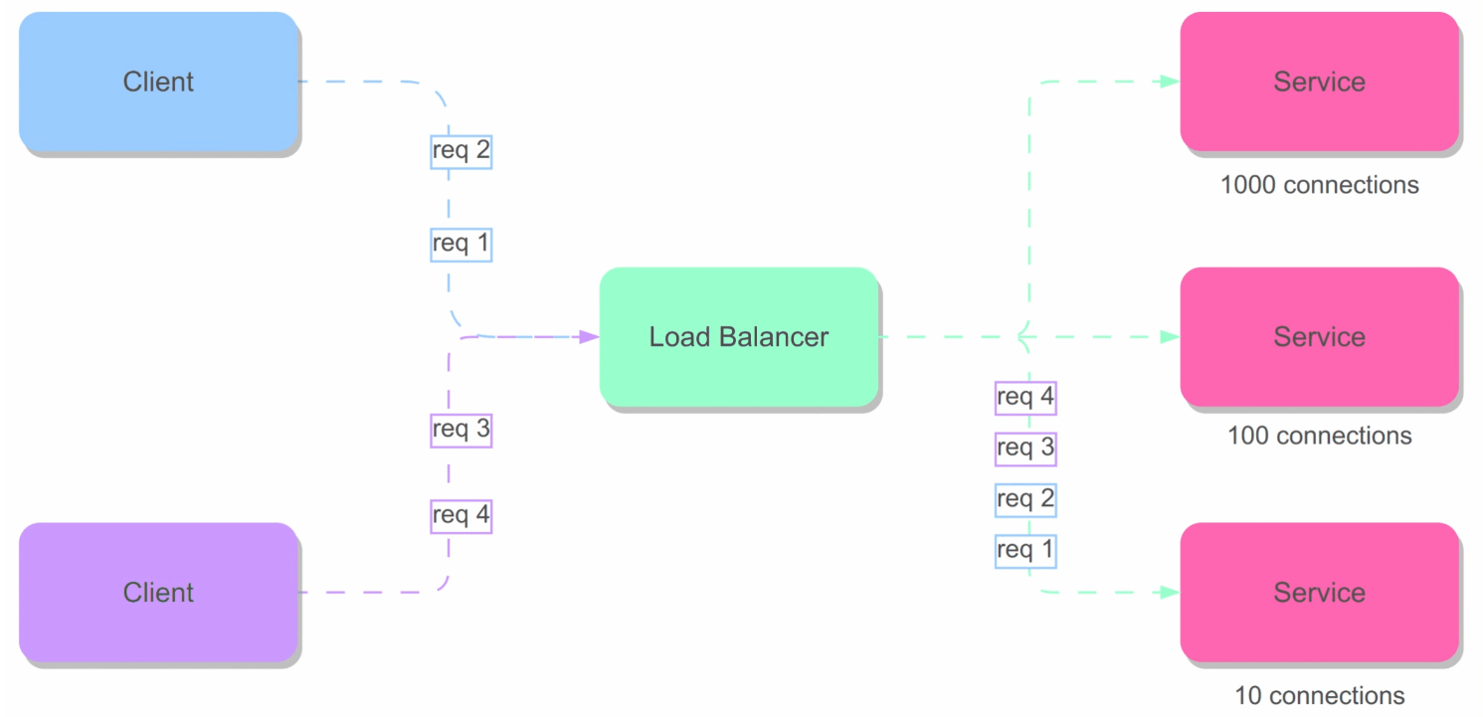
Least Connections

Slide 13
Response Time
The Least Response Time load balancing algorithm is a dynamic algorithm that takes into account the current number of active connections on each server, plus the average response time. This load balancer forwards the new request to the server that is currently serving the lowest number of active connections and has the shortest average response time.

Slide 14
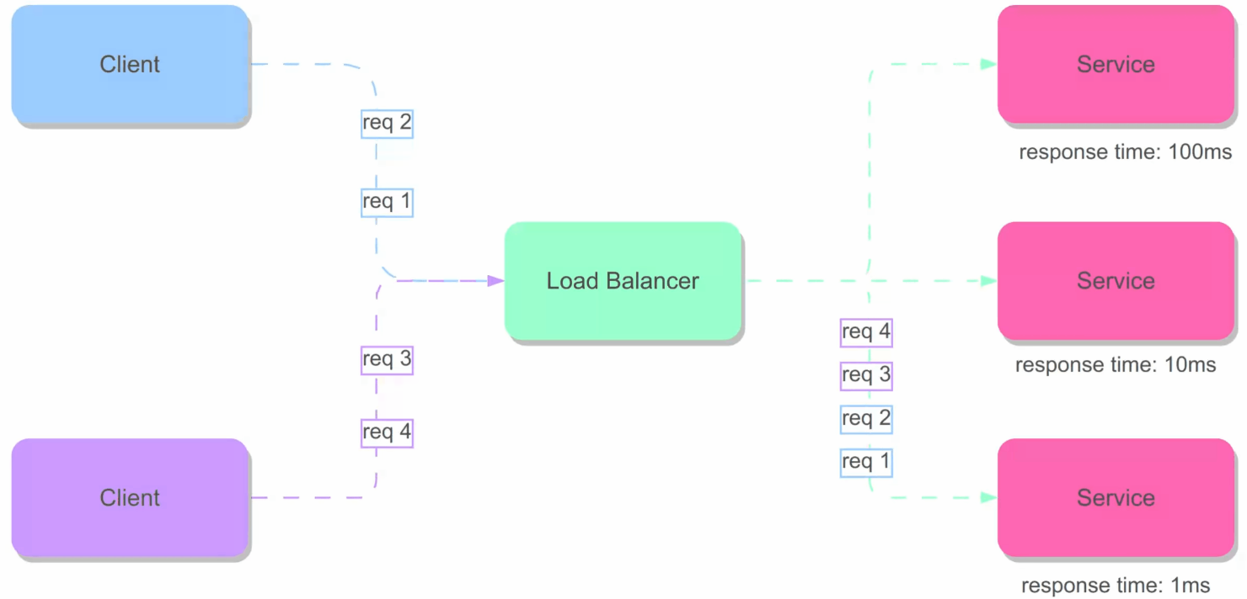
Response Time

Slide 15
Comparison
Algorithm Name | Pros | Cons
Sticky Round Robin | • Maintains session persistence • Improves user experience for stateful applications | • May cause load imbalance over time • Increases complexity in handling failures and scaling
Round Robin | • Very simple to implement • Evenly distributes new connections | • Doesn’t account for real-time server load
Weighted Round Robin | • Adjusts distribution based on server capacity • Balances load better in mixed environments | • Requires proper weight configuration • Static weights may not reflect real-time performance changes
Hash | • Ensures consistent routing for a given client • Easy to implement | • Can lead to uneven load if client IP distribution is skewed • Doesn’t adapt to dynamic server loads
Least Connection | • Routes requests to the server with the fewest active connections • Helps prevent server overload | • Requires constant connection monitoring • May not accurately reflect server load if connection durations vary
Response Time | • Chooses the server with the fastest current response • Can improve overall application speed | • Needs continuous performance monitoring • Susceptible to transient network fluctuations and measurement delays

